Slide 1

The fall and rise of Crypto Fraud
Jack Baylor
Notes:
Hello and thank you for attending todays talk.
I want to take out on a journey though the dark tangled web of crypto-fraud…. From the mundane and relatively benign to the modern day super heists, from the relatively simple attacks still effective in emerging markets to the latest advances in tactics, techniques and procedures of advanced cyber threat actors.

Slide 2
Who is Jack?
Passionate
Involved
Community Builder
Threat Researcher
Notes:
Passionate about protecting people, ideas and companies
Involved in DefCon and OWASP groups
Believes in building community both internally and developing trust with the wider industries and population
”Breaking Into InfoSec”
Currently workings as Sr Threat Researcher, CyberNinja recruitment agent, and operations manager for a non-profit based around vendor risk reduction.

Slide 3
Agenda
What is Crypto Fraud
Why did we see a rise in Crypto Fraud in 2018?
Where do we see its evolutionary direction
Notes:
So basically we’re going to follow the very basic format of What, Why, and So What?
WHAT IS IT?
WHY WAS IT POPULAR IN 2018
The evolution of cryptofraud, and the attack vectors it replaced.
Example of today’s main attack methods
What the real-world implications are for individual companies
Latest trends
Extrapolating from similar evolutions in other areas of the cybercriminal ecosystem
How can we impower ourselves to limit exposure, reduce risk and mitigate the after effects of a successful attack

Slide 4
What is Crypto Fraud?
Crypto-jacking
Browser based attacks
Wallet theft
Repurposed infostealers
Installed miners
Notes:
We will not be covering ICO scams or other types of investment related fraud, but rather concentrate on
two main types of cryptocurrency related malware attacks that are popular with cybercriminals
Namely:
Cryptojacking – what is it, how does it work, how does it affect us
Wallet theft – how a new source of income, and the demise of a previously profitable revenue source,
Fueled a resurgence in traditional infostealers and theft, and what happens when criminals hit the jackpot?

Slide 5
Cryptojacking
Use of computational power by adversary
Without knowledge or consent
Leverages:
Remote Code Injection
Traditional download
Notes:
Crypto-jacking
unauthorized use of someone else’s computer to mine cryptocurrency.
two distinct types of crypto-jacking:
browser based cryptojacking attacks,
which are normally script based
short term hijacking of CPU resources
via a compromised website or advertising delivery network on an otherwise innocent page.
The endpoint installation of mining software
Traditional trojan type
achieves long-lasting persistence on the infected host
crypto mining code then works in the background as unsuspecting victims use their computers normally.
The only sign they might notice is slower performance or lags in execution, until they get a bill!

Slide 6
Wallet Theft
Revitalizing traditional infostealers
Same techniques, new targets
Individuals – Companies – Exchanges
Notes:
Wallet theft:
Here we’ll examine the revival of traditional information stealers which now target cryptocurrency wallets and exchange log-in credentials
Due to the structure of usually decentralised blockchain based cryptocurrencies, the technical abilities required to rob a relatively small player or land a huge payday are practically the same, and depend on what sized new the attacker is using.
Techniques used previously in distributing adware, trojans and ransomware is now being repurposed to deploy cryptomining software.
Leveraging exploit kits through malvertising campaigns, watering-hole attacks via compromised websites and phishing emails, all the usual tried and tested techniques and being leveraged.

Slide 7
Why did we see a rise in Crypto Fraud?
Ransomware –The rise and fall
Increase crypto adoption globally
Advances in software
Increased sophistication in attacks
Notes:
So now we’ll quickly review how crypto-fraud became a major revenue source for cybercriminals and some rogue nation state actors.

Slide 8
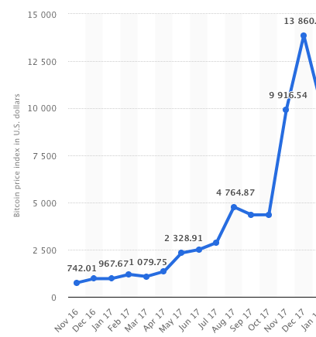
Ransomware – the rise
Notes:
Here we see the valuation of bitcoin through Nov 2016 to Dec 2017
Thanks to an exponential rise in the valuations of numerous cryptocurrencies
such as Bitcoin and Etherium throughout 2017 and into 2018,
coupled with the release of the source code of nation-state level cyber weapons such as
The Equation Groups Eternal Blue, ransomware attacks increased dramatically through 2017.
WannaCry May 2017, shortly afterwards, notPeyta
The widespread availability of ransomware related source code,
the emergence of Ransomware as a Service and the ease of creating wallets under
faked personas meant the lowering the technical and financial barriers of entry to this form for criminality.

Slide 9
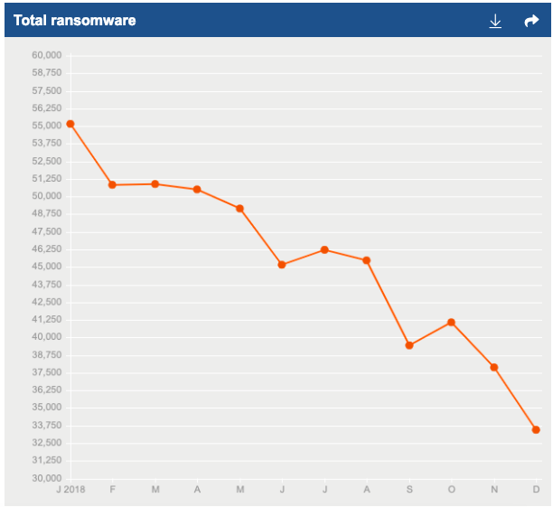
Ransomware – the fall
Notes:
However, this all changed in early 2018 when Bitcoins meteoric increase in value stopped,
and the market adjusted to a more realistic valuation,
dragging down prices on all other “alt coins” in the process.
Bitcoin dropped from a December 2017 high of $20k to $10k and now rests around $3k.
On the graph we see resulting decrease in ransomware attacks as witnessed by a single EDR vendor.
With the rate of return from ransomware attacks decreasing proportionally
to the value of cryptocurrency, ransomware as a revenue generation
source dropped in favour of other alternative revenue streams

Slide 10

Bitcoin loses favour
Price drops dramatically
Inherent difficulty for victims to deal in bitcoin
Ransom not realistic to many victims
Bitcoin wallets become monitored
No longer seen as private
Notes:
Also at this point in time, within international Law Enforcement circles,
it was now common knowledge that Bitcoin and its peers were becoming
the de facto units of currency for the cyber blackmarked, and highprofile
cases such as bringing down of the Silk Road and other market places
revealed that Bitcoin had been used to purchase everything from drugs to murder, a
nd bitcoin wallets, once thought to be completely anonymous,
were now being leveraged by the likes of the FBI to identify individual criminals
and being used as justification for arrest warrants.
Case in point was the detainment and arrest of 38 year old Frenchman
Gal Vallerius AKA ‘Magnificent Redbeard’, main administrator of the Dream Market
darkweb marketplace and mass distributor of illegal drugs such as Oxycontin.
It took a law enforcement taskforce spanning multiple countries to coordinate
their resources and monitor multiple accounts until they were able to detect multiple
transactions between the marketplaces main wallets and one owned by Vallerius himself.
He was arrested attempting to enter Florida to attend a beard competition.

Slide 11
Increase in crypto adaption globally
Large increase in privately held wallets
Increase adoption by companies
Large increase of number of Exchanges
Lack of regulation on “security” solutions
Notes:
So, with Ransomware decreasing in popularity, what could cybercriminals switch to maintain a revenue stream? Go directly to source.
Existing cryptocoins
Computational resources
For the generic public, crypto had become almost a mythical path to riches. the global value of cryptocurrencies increased dramatically in 2017 up to early 2018,
coinciding with the explosion of ICOs as potentially lucrative investment opportunities,
more individuals also began to purchase various cryptocurrencies and “HODL” or
hold onto the coins for speculative reasons, meaning the likelihood of an infected
“home” pc having a wallet increased dramatically, especially with-in certain demographics
such as men between the ages of 18 and 40, the online gaming community, and certain geographical areas.
These demographics were also likely to attempt to cash in themselves on the relative ease of mining
new coins by purchasing or building highspec “mining rigs”, essentially normal PC’s with multiple
High-powered graphics cards linked to provide the blistering computational power required to c
complete the “proof of work” calculations necessary to mine new coins such as Bitcoin, Etherium, LiteCoin and Monaro.

Slide 12
Increase in crypto adaption globally
Notes:
For industry, the rise of ransomware had lead to preventive measures occurring:
to mitigate their eventual infection. more and more companies began
to purchase bitcoin to hedge against possible successful attacks,
rather than waiting until an attack to occur first. This also would hopefully shield themselves
against an overly painful ransom payment as the value of cryptocurrencies
was rising dramatically. This resulted in an increasing number of corporations
now having their own cryptocurrency wallets or exchange accounts. In late 2017 the chief security architect at Citrix : “Businesses that have a stockpile of Bitcoin in anticipation of a ransomware demand
may now be tempted to cash in, given the surge in value,” he said.
“This could raise the risk to businesses, given the continued growth in ransomware attacks,
and a possible future rise in Bitcoin prices.
“Equally, those that do have large stockpiles may be at risk of being raided specifically for Bitcoin piles.”
CITRIX polled 500 companies with 250 staff or more, avg of 23 bitcoins being stored up. ($17k X 23 = ~$400k)

Slide 13
The rise of Crypto Jacking
Browser Based mining attacks
Download mining attacks
Notes:
Cryptojacking, in one sense, had been prevalent some years previously when
Bitcoin first started to take off in certain circles, certainly miners we being deployed
without permission on corporate, university and public infrastructure.
Certain technologies improved making them more deployable,
and the increased risk vs lowered reward for Ransomware
meant that cybercriminals who always follow the path of least resistance to achieve a
Viable return of investment, now needed new hunting grounds.
Lets not forget, cybercrime is now worth more than the international drugs trade.

Slide 14
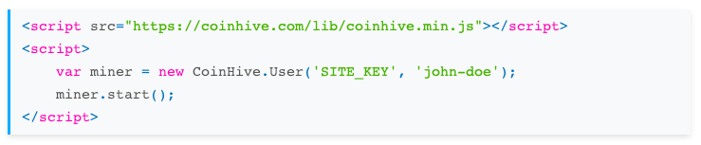
Why we can’t have nice things
Notes:
In December 2013 Quartz ran an article “By reading this article, you’re mining bitcoins”
It explained in detail the intracies of bitcoin cryptomining and postulated that it could
remove those nasty ads that were ruining our internet experience
At the time 1 bitcoin was $730. In the Summer of 2017, when bitcoin was about $2k, Coinhive developed a
JavaScript, browser based mining software
to provide website owners with an ad-free alternative to generate income from their pages.
Incredibly easy to setup, the lightweight software mined Monero, a virtually untraceable,
privacy focused altcoin, and initially this was a very positively received innovation welcomed
by many site users, both on 100% legitimate sites such as gaming review pages and adult content sites,
as well as by “gray” or outright illegal sites such as those hosing torrent files or worse.
Soon, unscrupulous content providers and cybercriminals began abusing the software
using the software without the endusers knowledge or consent.

Slide 15
Coinhive: evolution of identification
Welcome alternative
1
Unwelcome PUP
2
Malicious attack
3
Notes:
As security vendors began to label Coinhive and
similar solutions as Potentially Unwanted Programs (PUPs)
or outright malware, criminals did what they usually do,
they innovated. Software evolved,
methodology increased in nuance and tactics shifted.

Slide 16
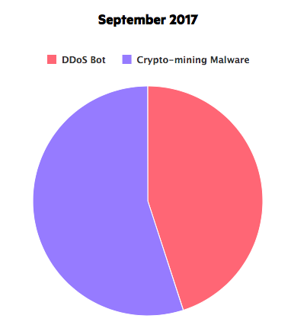
How bad can it be?
Notes:
So we ask, how crazy did this get? The answer: REDICULOUS.
Impervia Research: This is total percentages of Remote Code Execution in Sept 2017
(payload with malicious intent)

Slide 17
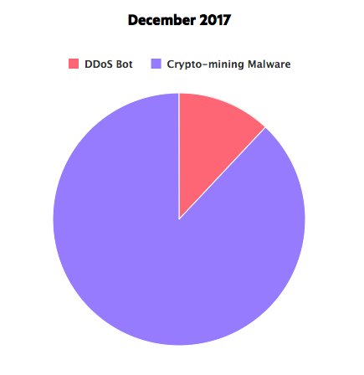
Oh… ok
Notes:
Impervia Research: This is total percentages of Remote Code Execution in Dec2017
(payload with malicious intent)

Slide 18
Browser Based Attacks: Further Evolution
Co-opting of previous TTPs from other campaigns
Modularisation of malware
Lower barrier to entry
Abundance of vulnerable servers
Notes:
Tactics originally used for adware such as
compromising servers for use in watering hole attacks,
injecting hidden iFrames, using malvertising and so on to create
behind the scenes pop-up/pop-under windows
enables the browser-jacking software to continue to mine long
after the initially compromised webpage was closed.
Usually this occurred when threat actors were able to inject
malicious code directly into unsuspecting advertising platforms or
vulnerable servers hosting content popular with those who would
either have powerful GPU’s, ie gamers, or who are unlikely to have
strong endpoint detection response software, such as users of “warez”
or hacked software and those who avail of movie streaming services.

Slide 19
Download based attacks
Multiple attack vectors
Traditional Exploit Kit delivery
Supply-chain attacks
Trojanisation of legitimate software
Discrete installation of mining software
Notes:
DOWNLOAD BASED ATTACKS
Traditional adware techniques include software bundling designed to fooling enduser into agreeing to install monitised PUPs or Adware were leveraged to install discrete mining software directly onto endusers harddrive, enabling the mining to achieve persistence on the endpoint meaning mining could now continue even after reboots.
Supplychain attack on a major software provider which resulted in users unwillingly installing mining software via the compromised 3rd party addon of a legitimate PDF editing application. The threat actors had managed to compromise the targets cloud instance, completely replicate the PDF editors web facing infrastructure on another server, copied all of their targets MSI files, including font packages, which were all digitally certified. They then modified one single file, an Asian fonts package delivered as an MSI file, to download and install the malicious coin-mining software without the endusers knowledge, with SYSTEM privilages and control.
Another attack discovered in Brazil in mid 2018 involved 200,000 Lativan made MikroTik routers by exploiting a flaw in Winbox, a remote management service that runs ontop of the devices operating system RouterOS. The real kicker in this stuation? The infection is spreading to non-MikroTik devices as some Brazillian ISPs incorporate MikroTik routers within their own infrastructure. Whats also interesting here is that they leveraged the same vulnerabilities that presumably nation state threat actors utilized to spy on more than 100 targets in 11 countries, with a significant portion of these targets most notably located in Yemen, during what Kaspersky dubbed “Operation Slingshot”… which in itself may have been leveraging TTPs obtained from the leaked “Vault7” tool known as “ChimayRed”

Slide 20
Targets
Traditional endpoints
IoT devices
Network devices
Cloud
Notes:
So we’re seen a widening of the target landscape as threat actors harness more
And more of our connectivity against us. Not just traditional endpoints,
But network devices, IoT devices and both traditional server and cloud infrastructure
Server attacks affecting cloud instances have also become prominent,
leveraging remote administration tools
such as Windows Management Instrumentation (WMI).
Cryptojacking malware such as PowerGhost has the ability
to spread laterally across networks from infected endpoints
such as a user’s laptop or desktop and establish itself in
connected servers. We’d also previous seen this lateral movement
and “living off the land” from Wannamine, which, like WannaCry,
leveraged Eternal Blue to compromise unpatched legacy systems.
MassMine leverages Eternal Blue, DoublePulsar and GhostRAT
As well as other exploits, tools and can even disable a number of anti-virus
Security toolfeatures.

Slide 21
Download Attacks: Rocke
Environmentally aware
Anti-analysis techniques
Detected & Removed Security
Targeted Linux servers
Notes:
Rocke:
Enters via advanced Apache, Oracle and Adobe coldfusion exploits
Downloads backdoor and opens a shell to C2 server
Downloads and executes shell script
Uses advanced anti-detection and analysis evasion
Detected and disabled Chinese cloud security products
Disabled existing mining software
Prevented the installation of new mining software
Installed Monero crypto miner
- share some codebase with another threat actor, known as the Iron Cybercrime Group,
showing continued collaboration and innovation within the wider cybercrime community.
As knowledge and experience is shared between veterans of multiple malware stacks, the continued advancement of complexity and effectiveness is guaranteed.

Slide 22
Wallet Thefts
More “traditional” form of crypto fraud
Repurposing of existing infostealers: Dridex, Zeus
Introduction of new infostealers: Vidar
Leveraging existing infrastructure
Hybridisation of attacks
Notes:
Traditional wallet theft: the resurgence of the Infostealer
Criminals love two things: ease of use and high return on investment.
With the simple repurposing of existing malware and
infrastructure such as Exploit Kits to harvest wallet and exchange credentials,
criminals can continue to attack vulnerable victims with minimal retraining.

Slide 23
Resurgence of the Infostealer
Zeus
Dridex
Emotet
Lokibot
Notes:
The repurposing of existing and well documented infostealers such as
Dridex and Zeus to now also concentrate on crypto wallets
and exchange log in details means a resurgence in infostealers,
with new players such as Vidar working in tandem with other
malware to maximise ROI and hopefully hinder detection
The key concept here is continuous innovation while driving down
financial and technical barriers to entry for criminals

Slide 24
Vidar: crime-as-a-service
Notes:
Written in C++, coming to international attention around October 2018
and building off the Malware-as-a-Service
success stories seen during the height of the Ransomware attacks,
Vidar is a commercial threat available for $700, a relatively low barrier
for entry for even the most junior or novice of cyber criminal.
Vidar also has the ability to target virtual wallets storing cryptocurrencies
As well as other more traditionally valuable data such as passwords, contacts, documents etc.
Much like other infostealers, Vidar is designed to operate secretly,
leaving infected victims unaware that their systems have been compromised. Here we see a snapshot of its web-interface, with which a budding cybercriminal can tailor
their attack in multiple ways with very little prior knowledge required.

Slide 25
Wallet Attacks: Vidar
Notes:
Vidar:
Uploads malicious Ad to unsuspecting advertising platform
Malicious add delivers Fallout Exploit Kit
Downloads Vidar
Checks that its NOT in Russia or one of 4 other ex-Soviet countries
Vidar steals all available information
Uploads to C2 server
GranCrab downloads
Ransomware locks machine

Slide 26
Hybrid Attack: CookieMiner
Targets Mac endpoints: computers and iPhones
Steals browser cookies for exchange, wallets
Steals browser passwords, credit cards, texts etc
Retains control through backdoor
Download and installs Koto coin-miner
Notes:
CookieMiner:
Steals Google Chrome and Apple Safari browser cookies from the victim’s machine
Steals saved usernames and passwords in Chrome
Steals saved credit card credentials in Chrome
Steals iPhone’s text messages if backed up to Mac
Steals cryptocurrency wallet data and keys
Keeps full control of the victim using the EmPyre backdoor
Mines cryptocurrency on the victim’s machine

Slide 27
When wallet-theft hits the jackpot
Youbit:
South Korean company
lost 17% of its assets in one hack in Dec 2017
NiceHash:
Slovenian based mining company
hacked for 4700 BTC
Notes:
South Korean cryptocurrency exchange said on December 20 2017 it is shutting down and is filing for bankruptcy after losing 17% of its assets in a hack attack.
The attack caused a loss in a coin withdrawal wallet (hot wallet). The loss is worth about 17 percent of its total assets and there were no additional losses as the other coins were kept in a cold wallet. It had previously lost $88 in a recent attack
NiceHash Hack
Slovenian based mining company NiceHash was hacked for 4700 BTC which is ~$80 million.
Dec 2017

Slide 28
APT?
Lazarus
Wannacry
$550 million at least
Gorgon
Nation State & Criminal
LokiBot & NanoCoreRAT
AppleJesus Mac malware
Uses URL shortening service
Notes:
Lazarus Group, famed as North Koreas main military cyberwing, responsible for the Sony Hack,
Wannacry, and the SWIFT network have begun targeting exchanges, getting over half a billion from Coincheck in Japan
Gorgon Group fights on behalf of Pakistan, and has targeting multiple nation states such as India, UK, Spain, Russia and the United States of America. Theres huge overlap between the tools and infrastructure the use for targeting nationstate level survailance and spying and their criminal enterprises, suggesting they’re either a 3rd party “for hire” crew or simply unsupervised by their command structure – all usually using malicious documents via spam / phising to execute a Powershell command and download a secondary payload.

Slide 29
Evolution of Wallet Thefts
Continue to adapt to market changes
Greater targeting of emerging markets
Greater targeting of unregulated Exchanges
Greater hybridization of attacks
Increase of attacks on the blockchain
Notes:
Hybrid attacks – most obvious damage/attack no longer the only one executed –
meaning DFIR teams now need to focus more on discovering any increased
exfiltration of data via unusual network traffic before final stages were executed
Increased costs for victims – associated costs of undoing damage from ransomware/wipers
as well as increase cloud costs, CPU / electricity costs etc in server farms or from cloud resources
51% type attacks / replay attacks – hijacking of entire blockchains to carry out fraudulent transactions or to cover up major heists on individuals and exchanges alike. . . . 51 percent attack occurs when a single entity takes control of over 50 percent of the overall mining power in a Proof-of-Work (PoW) blockchain
Increased targeting of industry stacks that rely on the cloud such as educational institutions, resulting in larger costs on infrastructure, energy etc.
GDPR – resurgence of highly evolved infostealers operating as MaaS with little technical or financial barriers to entry mean increased dangers since the introduction of GDPR.

Slide 30
Conclusion: What have we learned?
Crypto Fraud continues to evolve
National and International laws need to catch up
Greater enduser training
Greater use of EDR
Greater use of baselining servers – physical and cloud
Robust patching policies
Notes:
National laws need to be updated to tackle these issues: Japan recently convicted the first ever person for maliciously using Coinhive, 90 downloads of his game cheat software and generating approximately $45 dollars.
Endpoint users need greater training in emails / documents containing macros
Endpoint script control preventing the execution of one-liner PowerShell scripts from downloading the mining software
Wifi hotspot providors need to have greater vigilance to ensure their portal pages remain uninfected and their routers are not compromised
Greater focus on robust patching policies to ensure the updating of software especially browsers to prevent clickjacking – Android current about 20% of devices are fully updated, Firefox consistently within top 10 unpatched software.
At risk verticals such as Healthcare and older SCADA / ICS industries need to reevaluate their potential risk posture and vulnerabilities to these attacks. This is both with their existing legacy infrastructure, linux based enpoints and adoption of IoT. So too with Education, regarding its reliance of legacy endpoints, retention of physical server farms and now increasing adoption of cloud infrastructure to facilitate remote students.
In general, companies need Greater focus on baselining cloud instances
Greater analysis of what data is being stored vs needs to be stored

Slide 31
Would you like to know more?
Vidar: 1 and 2
Rocke: 1
CookieMiner: 1
Cryptomining: 1 and 2
Lazarus Group: 1 and 2
Gorgon Group: 1

Slide 32
Any Questions?

